Slide 1

Resource Materials on North Korea at the Library of Congress
Sonya Lee
Reference specialist
Library of congress
Notes:
Good morning.
I’d like to thank CKM committee for giving me a chance to talk about the North Korean Resource Materials at the Library of Congress.
Before my main topic, I'll start with a brief introduction.

Slide 2
What is the Asian Division at the Library of Congress?
The custodial division managing Asian collections and Asian reading room services.
Provides public access to more than 4 million items in over 130 Asian languages.
Covers the South Asian subcontinent and Southeast Asia, China, Japan, and Korea.
Notes:
As the primary public access point for researchers / seeking to use the Asian collections of the Library of Congress , The Asian Division / covers the area/ from the South Asian subcontinent and Southeast Asia to China, Japan, and Korea.

Slide 3

In the Beginning…
1950: The Library began to collect Korean materials
1955: The Library started to systematically acquire materials
1966: The Republic of Korea and the United States government signed an exchange agreement
Notes:
This is a brief summary of the Korean Collection. (Click)
The Library started to collect Korean materials in 1950 during the Korean War. Then, the Library’s Korean Unit was the only office among the US government that collected materials about Korea. / Any requests related to Korea were sent to the Korean Unit. The collection quickly developed over the following years. (Click)
From 1955, the Library started to use a vendor in Korea to systematically and regularly collect contemporary publications. (Click)
1966 was an important year for the Korean Collection. The US and South Korean government signed an exchange agreement, in which the Library acquired government publications on different topics, which has become one of the most significant strengths of the Korean Collection.
The collection is now one of the most extensive and comprehensive collections outside of East Asia.

Slide 4
At the Library of Congress…
The Korean Collection contains:
  303,000 volumes of monograph
  Over 7,600 serial titles
  3,300 volumes of rare items
  Over 10,000 items from North Korea
  278 serial titles from North Korea
Notes:
The Library has an extensive collection, which includes a variety of materials, / such as / more than 10,000 items and 278 serial titles from North Korea.

Slide 5
The North Korean Collection
Contains one of the largest North Korean materials in the world
Biggest collection of serials from the 1940s-1960s
All primary sources from North Korea
Notes:
Let’s / get to / the main part of the presentation. North Korean collection …
The Library contains one of the largest NK materials in the world and Provides users with greater access to old and new North Korean materials freely. (Do Not Click)
Because of these reasons, There is a high demand from researchers / for access / to these items.

Slide 6
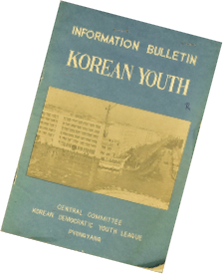
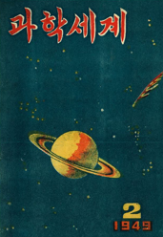
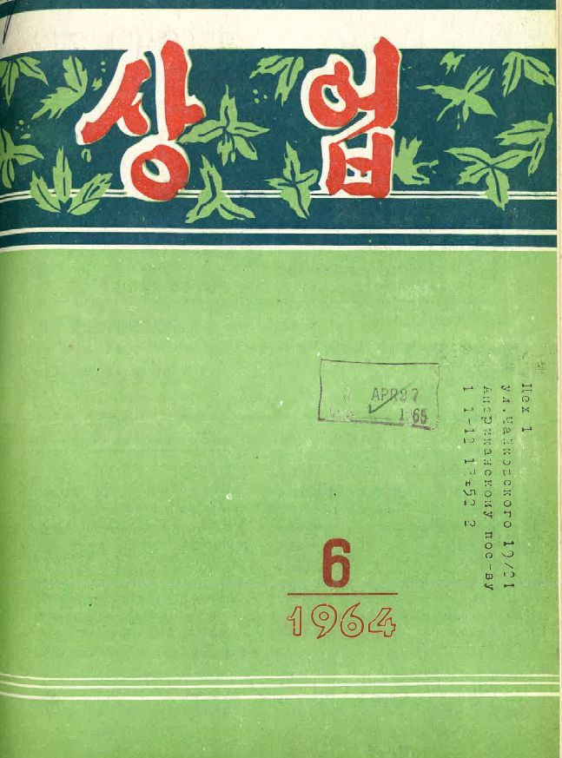
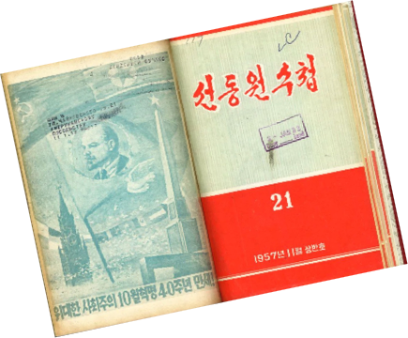
North Korean Collection
Notes:
Once a North Korean scholar told me our collection is like a playground of NK materials. (South Korea – National Security Law)
When I started working at the Library, I thought it would be a straightforward to serve the users with NK materials. However, soon I could see it was anything, but straightforward. It was quite a complex.

Slide 7

Notes:
This was exactly what I felt.

Slide 8
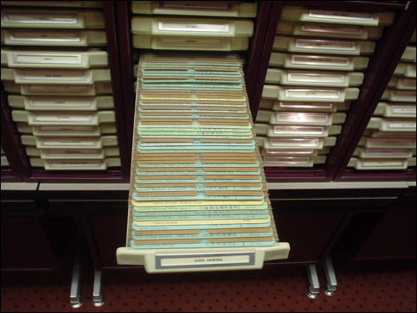
Korean Serials Visual Files
Notes:
It all started with one inquiry, “all north Korean serials list, please.” After receiving the same question a few times, I thought , “What should we do about it?”
Then, we used the Serials Visual files (like this image) to serve the users ... it was impossible to respond to the demand for requests.
So, We pulled all Korean serials // at the Library, over 7,000 titles. We developed a Korean serial database by reviewing each title, adding the country code, adding subject by LC call number, and titles in Korean character.

Slide 9
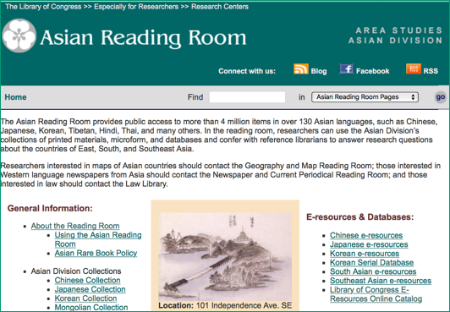
Korean Serial Database
Korean Serial Database
http://www.loc.gov/rr/asian/koreanserials
Notes:
Korean Serial Database: (Not Click)
Korean Serial Database is A friendly and powerful reference service tool.
It provides researchers / detailed information / about the rich and diverse serials at the Korean Collection.

Slide 10
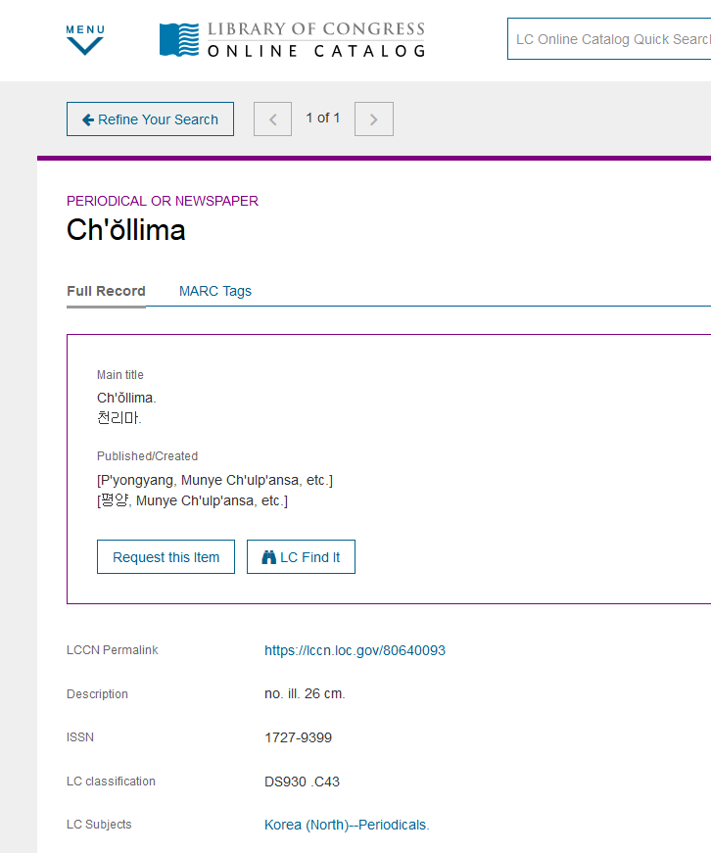
Korean Serial Database
LC Subjects: Korea (North) - Periodicals
Notes:
Let’s look at one example why the Korean serial database is a powerful reference Service tool. Chollima is a frequently used NK serial. (Click)
When we pull its record, LC subject heading is: Korea (North) - periodicals. (we can see) there is Not much subject information, except Periodical from NK.

Slide 11
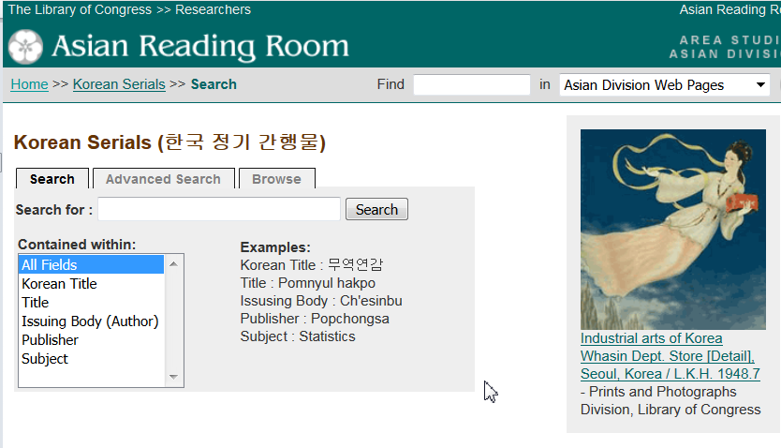
Korean Serial Database
Notes:
Korean Serial Database enables / Researchers / to search using all fields, titles, Korean Title, name, Issuing body, publisher, Newspaper (click right away)

Slide 12
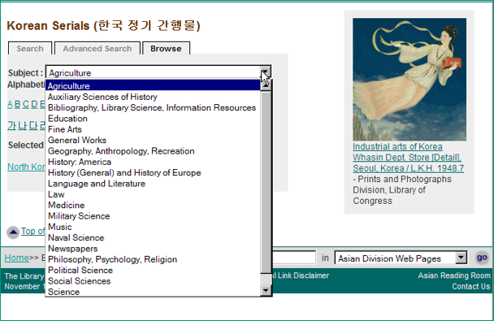
Korean Serial Database
Subject Searching
Notes:
And the Subject, which adds value / to searching the Database.

Slide 13
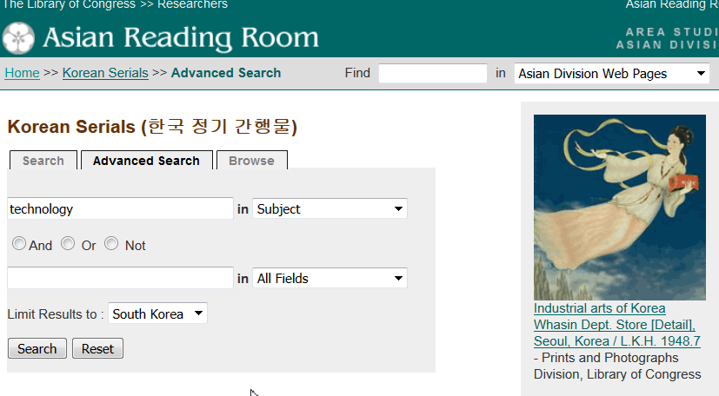

Korean Serial Database
Notes:
By using Advance search, you can limit your result to both Koreas or just South or North Korea.
Let’s search “All serials on technology / published just from South Korea.

Slide 14
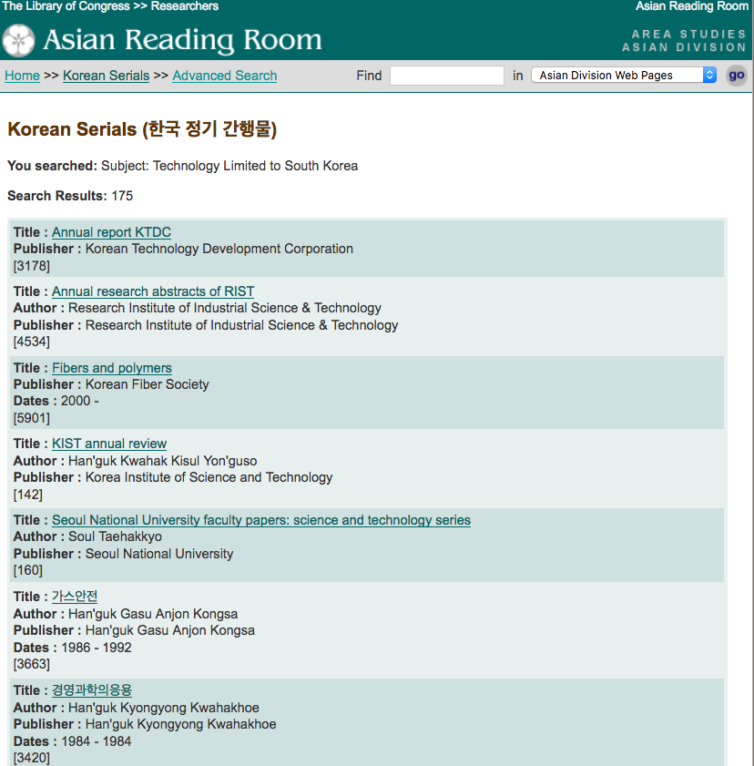
Korean Serial Database: Advanced Search - Technology Limited to South Korea
175 results
Notes:
A total of 175 results ... from this list, click one title to get the short records.

Slide 15
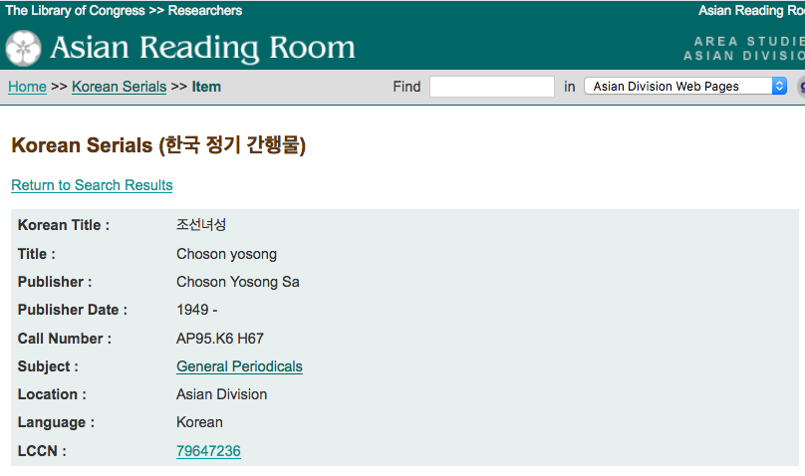
Korean Serial Database
Click LCCN to see Full Record
Notes:
From this short record, you can review a full bibliographic record by clicking the LCCN (Library of Congress Control Number)

Slide 16
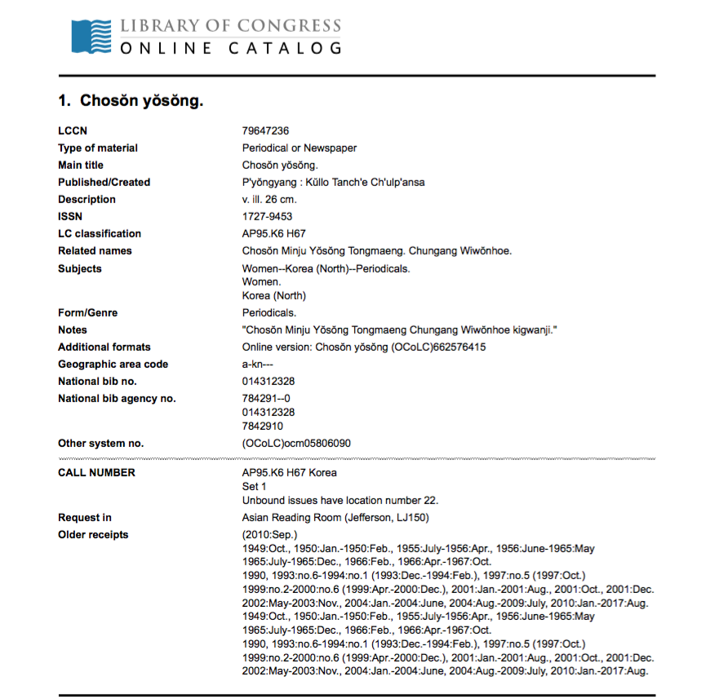
Korean Serial Database
Notes:
(Be quiet)

Slide 17
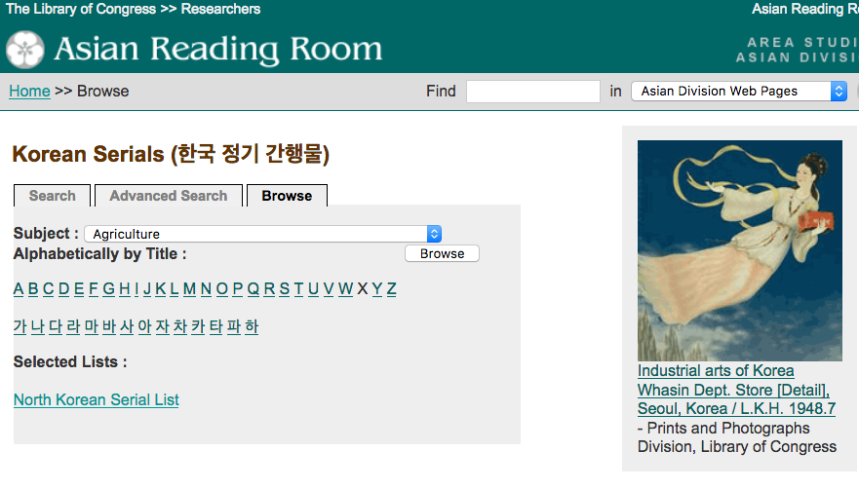
Korean Serial Database
ALL North Korean Serials List
Notes:
If you remember / we reviewed each serial title and added the country code, either North Korea or South Korea.
And now, we can get “all North Korean serials list, with just one click on the browse option

Slide 18
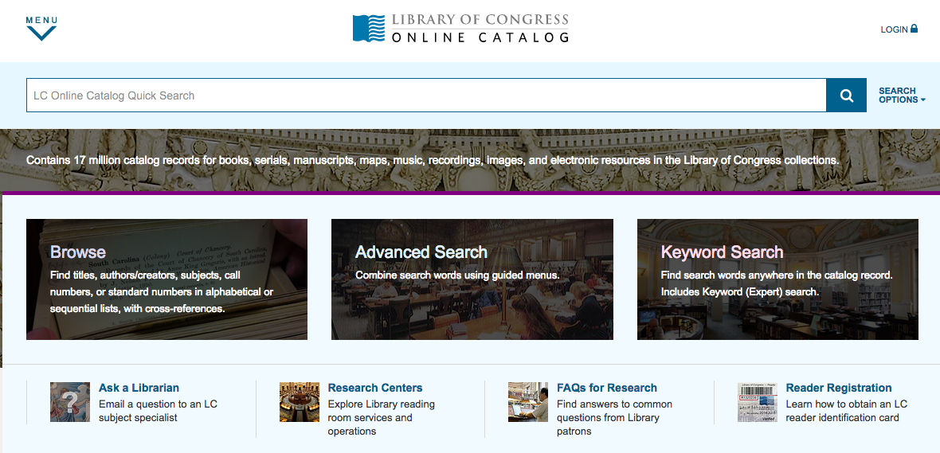
Library of Congress Online Catalog
Notes:
Let's move to the next part of the presentation.... how to search the books from North Korea.
The Library’s Online Catalog contains approximately 17 million records representing books, serials, manuscripts, cartographic materials, and etc..
It includes 3.2 million catalog records from an earlier database. These records, mostly for books and serials, cataloged between 1898 and 1980. We call these records, as "pre-marc records.” Pre-marc records are being edited to comply with current cataloging standards.
However, searching these records becomes a much more complex process because of the inconsistent practices.

Slide 19
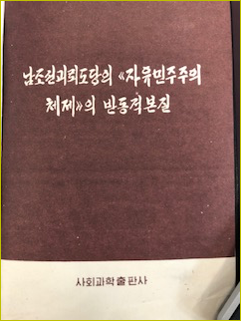
Library of Congress Online Catalog
남조선 괴뢰도당의 <<자유 민주주의 체제>>의 반동적 본질
Notes:
How would you search this book, 남조선 괴뢰도당의 <<자유 민주주의 체제>>의 반동적 본질 from North Korea? Let’s check its record first

Slide 20
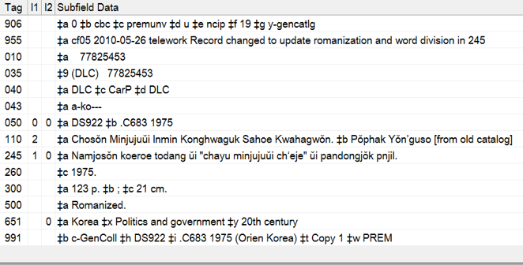
Library of Congress Online Catalog
Notes:
This was the original record when I found this book.
The record did not have country code, publication information (except published in 1975), And had Wrong Spell (pnjil).

Slide 21
Library of Congress Online Catalog
Kn for North Korea
Pnjil -> ponjil
Pʻyŏngyang, Sahoe Kwahak Chʻulpʻansa
c-GenColl -> c-Asian
Notes:
So, I manually modified the record by adding the country code (click)
(kn for north Korea),
(click) correct the spell from pnjil to Ponjil,
(click) publication information from the book (Pyongyang and Sahoe Kwahak Chulpansa),
(click) and changed holding information. (click)

Slide 22
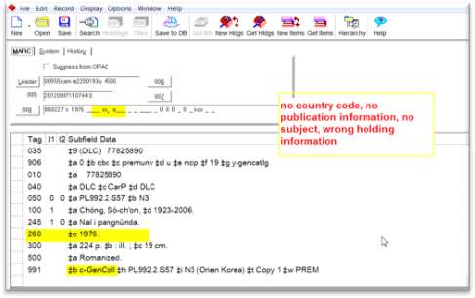
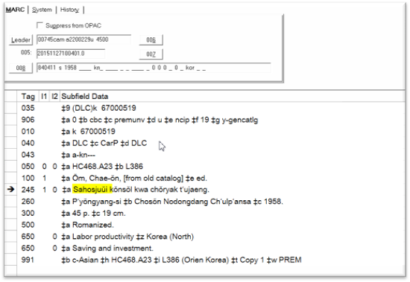
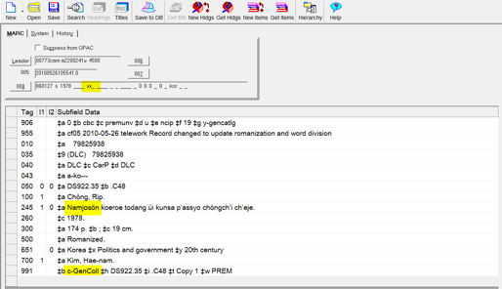
No Country Code
No Publication Info
No Subject
Wrong Holding Info
Wrong Spelling
Inconsistent with Spacing Practice (e.g.Namjoson)
Notes:
These are some of the common examples of pre-marc records.
No country code, no publication information, no subject, wrong holding information, and partial title with word(s) omitted are common issues (Click!)
Wrong spelling (Click!) and different practices of word division ---
Inconsistent with spacing practice are another challenging, such as Namjoson.

Slide 23
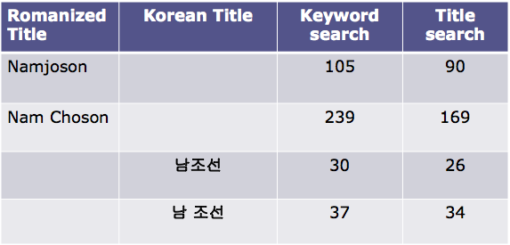
Voyager - Space Matters
Notes:
Spaces do affect searching in Voyager.
From the previous slide, the keyword searching “Namjoson’ without space, retrieves 105 results with keyword search and 90 results with title search. With space (Nam Choson), 239 results with keyword search, and 169 results with title search.
There is no easy way to identify real issues, update, and modify records.
Last a couple of years, we have retrieved them and manually modified them one by one by adding the country code (mostly North Korea) and whatever necessary needs to be added so they can have accurate records. (click)

Slide 24
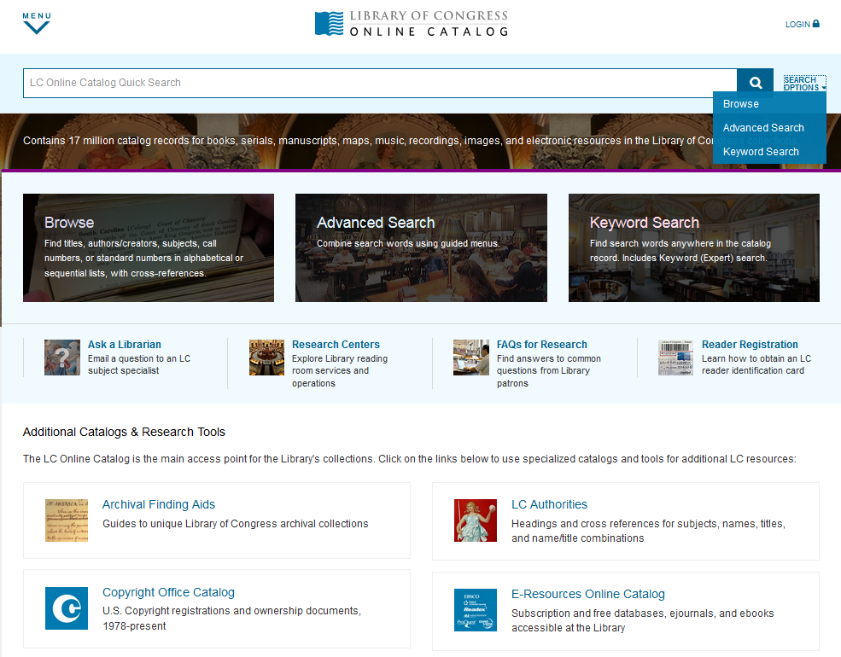
Library Online Catalog -
Advanced Search
Notes:
Advanced Search can be useful to find NK publications.
When you search / for / the North Korean books from the Library of Congresss' online catalog,/ we recommend /to use this tip to make your search more efficient.
Enter your search term, such as subject and leave Boolean operator as AND, and entering "pyongyang" as Publication Info. When we modify pre-marc records, we make sure that records has Pyongyang as the place of publication "

Slide 25
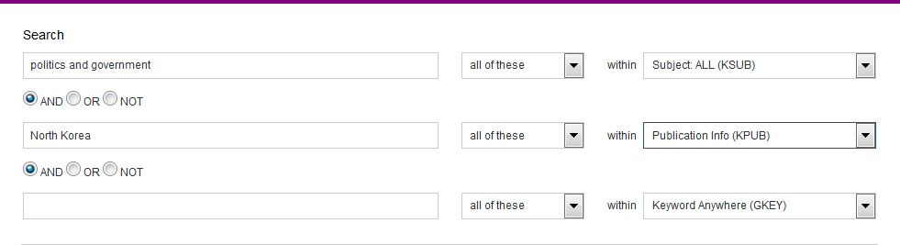
Library Online Catalog - Politics and Government + North Korea
Notes:
Let’s see how it works.
We’d like to retrieve primary sources from North Korea on Politics & government.
So, we enter phrase “Politics & government” as subject and enter North Korea and select publication information,

Slide 26
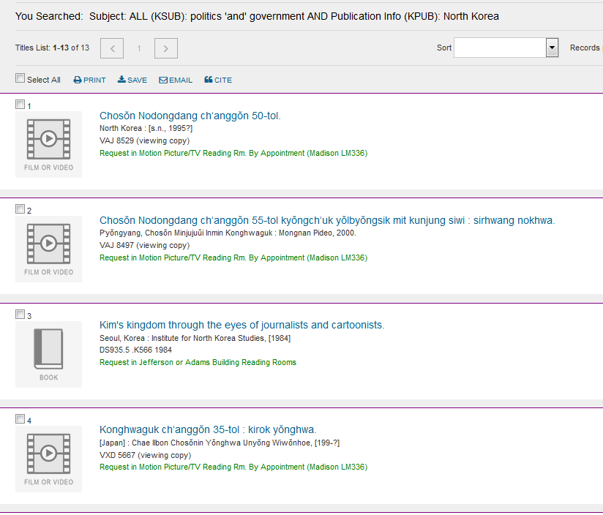
Library Online Catalog - Politics and Government + North Korea
Notes:
Retrieved 13 results –Which includes:
3 films from NK
2 Films from Japan
4 books from s. Korea
4 books from Washington DC
So, we could not find the record we were looking for

Slide 27
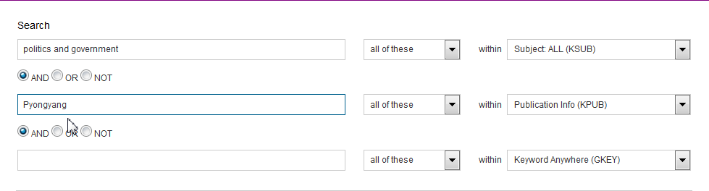
Library Online Catalog
- Politics and Government + Pyongyang
Notes:
This time. we typed “Politics and Government” as search term and Pyongyang” as Publication Info.

Slide 28
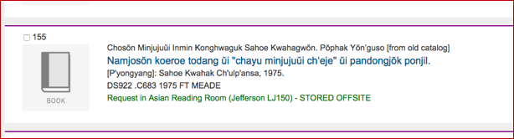
Library Online Catalog - Politics and Government + Pyongyang
Notes:
Here we retrieved a total of 270 records from the search and we found the record.

Slide 29
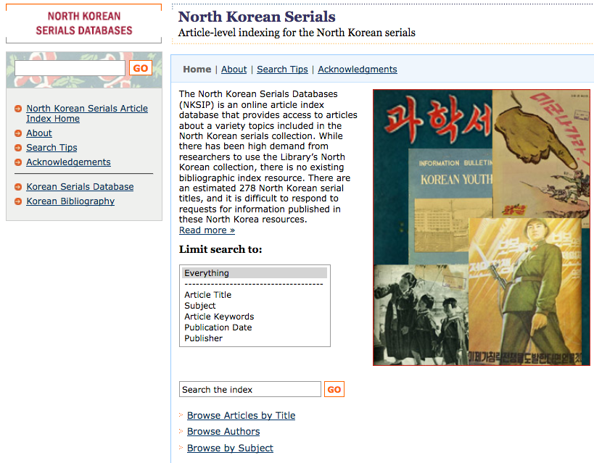
North Korean Serials Indexing Project (NKSIP)
http://memory.loc.gov/diglib/asian/html/nksip/nksip-home.html
Notes:
Lastly, North Korean Serials Indexing Project (NKSIP).

Slide 30
North Korean Serials
Indexing Project (NKSIP)
Project Background
One-of-a-kind materials, which may not be available in North Korea.
Contains publications from as early as 1948, the year the DPRK was established through the present.
There is no article index resources for the articles published in North Korea.
Notes:
(Only Read This note!!!) North Korean serials at the Library / are / One of a kind materials, which may not be available even in North Korea
Contains publications from as early as 1948
There is a high demand from researchers / for access to specific articles and topics / included in these collection.
But, There is no article index resources / for the North Korean serials.
So, it is Incredibly difficult to respond to request..

Slide 31
North Korean Serials
Indexing Project (NKSIP)
Goals
To build an article-level index for the North Korean serials in the Library of Congress.
To make the index available online for researchers and scholars to use.
To make these special collections accessible to a wider audience.
Notes:
(Read only the Note)
NKSIP originated with the Korea Foundation grant in 2008.
We started this project with the following goals – to build an article index for the NK serials, and to make the index available online for researchers and scholars to use.
To date, a total of 34,000 article index records have been created.

Slide 32
North Korean Serials Indexing Project
Notes:
NKSIP lets you study North Korea / in unusual depth.
The database allows researchers / to search / using (Everything), Article titles, Subject, Article keywords we added from articles, publication date, and publisher.
Researchers can also browse by Article by title, authors, and subject.

Slide 33
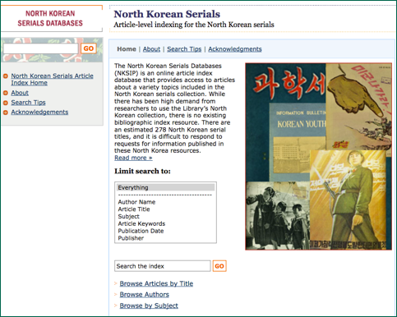
NKSIP - Subject Search
Subject Search
Notes:
To search / by subject– You may enter / any term or phrase/ and choose Limit by "Subject".
Alternatively, you may select “Browse by Subjects”. (total 135)

Slide 34
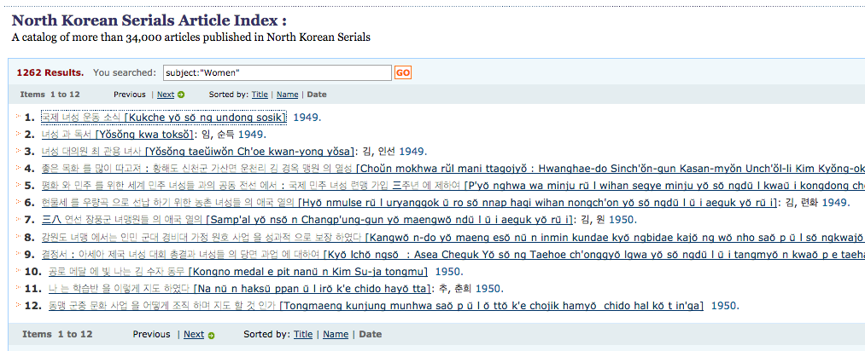
NKSIP - Subject Search
국제 녀성 운동 소식
Sorted by Title / Name / Date
Notes:
Tried the Subject search with Women and retrieved a total of 1,262 articles.
We can sort by Title, Name, and Date for all searches. “Date sort” is useful. esp. dealing with these many results. / (Click) /
Let’s open the 1st article, “Kukche yosong undong sosik

Slide 35
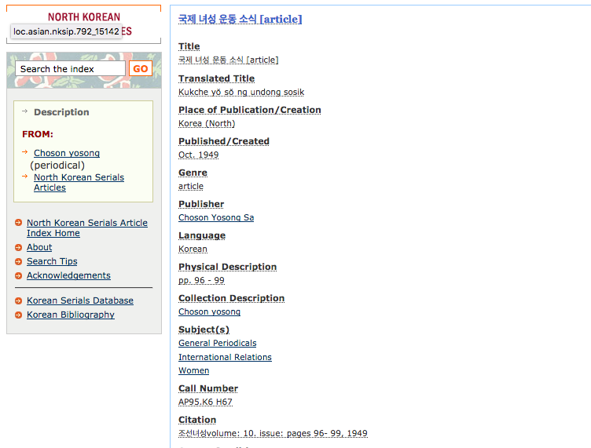


NKSIP - Subject Search
Notes:
The record shows: title in Korean, Romanized title, Published information, publisher (Choson Yosong sa), keywords and Citation information - from Choson yosong, 1949, vol. 10, page from 96-99. (click)
From this point, you can check the cataloging record of ”Choson yosong" from the breadcrumbs on the left.

Slide 36
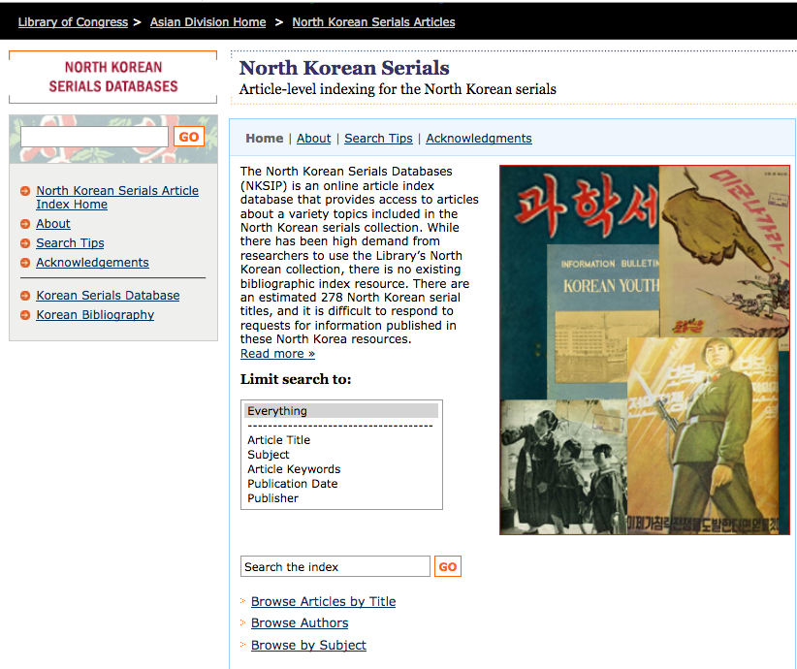
NKSIP - Browse Authors
Browse Authors
Notes:
To make searching more precise for Author Name, you can choose “Browse Authors” which has a total of 11,078 names in Korean and romanized Korean form).

Slide 37
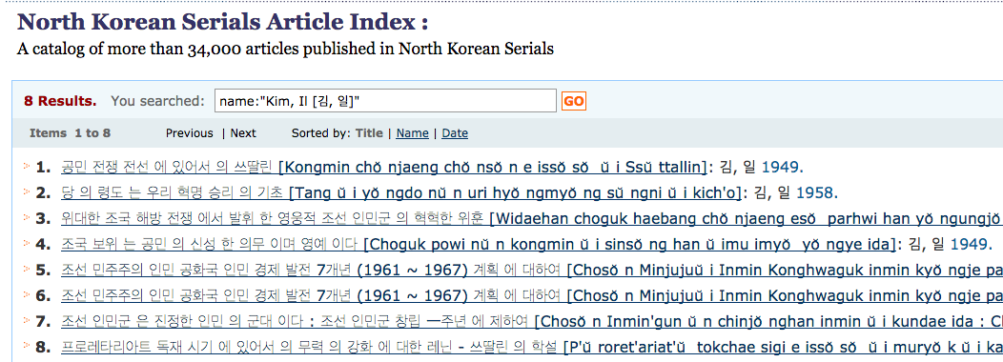
NKSIP - Browse Authors
Articles by Kim, Il
Notes:
From Author browse with Kim, Il, -- retrieved 8 results. Kim il was the one who joined the armed resistance against Japanese colonial rulers with Kim Il-song.

Slide 38

NKSIP - Advanced Search
Subject
Number of Results
Economics AND Date:1958
754
12
Economics AND Date:1958
AND 남 조선
Notes:
Advanced search features lets you do Boolean operators with AND, OR, or NOT. Let’s see a few examples … (Click)
Looking for articles with Economics as subject and published in 1958) – retrieved total 754 results. (click)
Now, we would like to have records only related to South Korea → Economics as subject and Uppercase AND date:1958 and Uppercase AND "남 조선") 12 results
As you can see, you can take advantage of advanced search features like other databases. (I want to say again, “please take advantage of advanced search features like other databases).

Slide 39
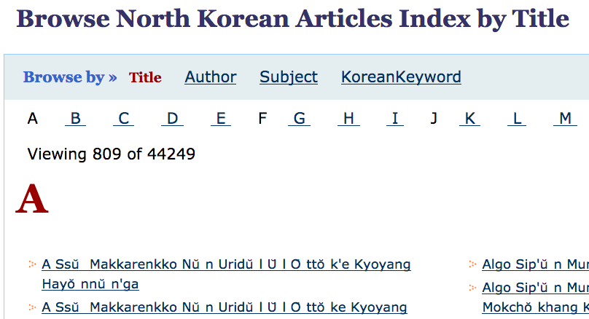
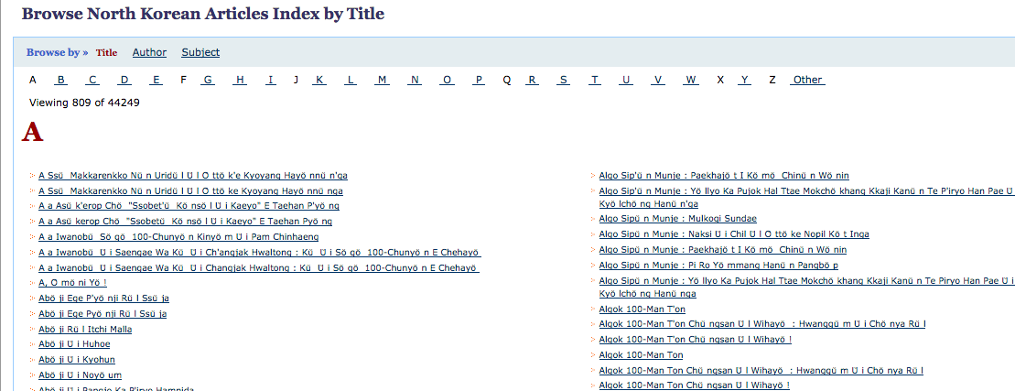
NKSIP - Browse Articles by Title
Notes:
All Articles indexed / can also be displayed. Of course if you have time, you can browse through / all of them/ / this way. (Alternate title)

Slide 40
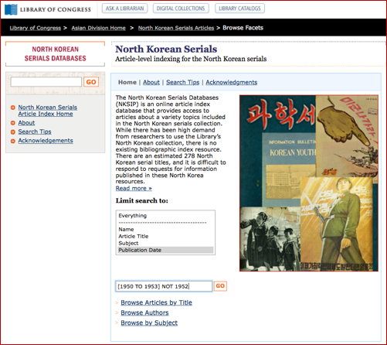
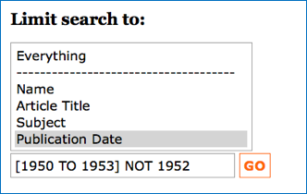
NKSIP - Search by Publication Date
Notes:
Also, you can search articles from a particular year or years by entering the year and limit the search to "Publication Date”
To search for articles / in a range of years/ use square brackets (and upper case "TO") . You can also add NOT in uppercase to skip a year.

Slide 41
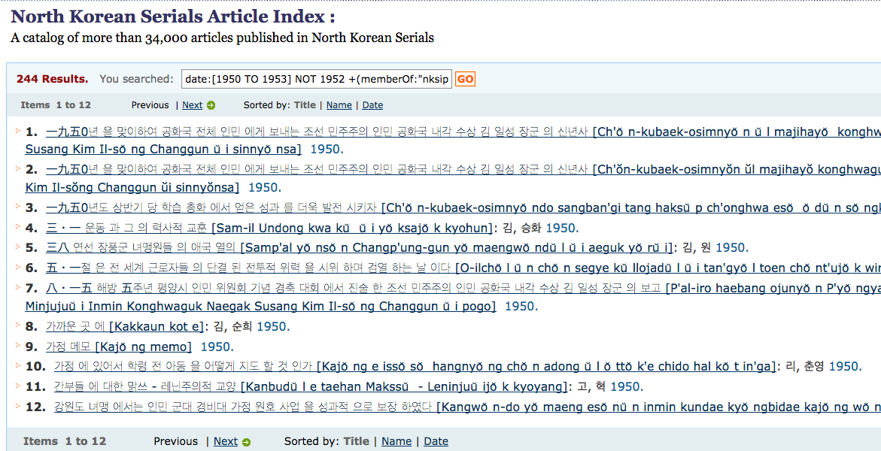
North Korean Serials Indexing Project
Articles from 1950 to 1953, not 1952
Sorted by Title / Name / Date
Notes:
For example, I tried to search articles from 1950 to 1953, but not 1952. I use square bracket [1950 “TO” 1953] and add NOT to skip 1952.
Here are the 244 results from this search and (Again) Date sort will be useful in this case.

Slide 42
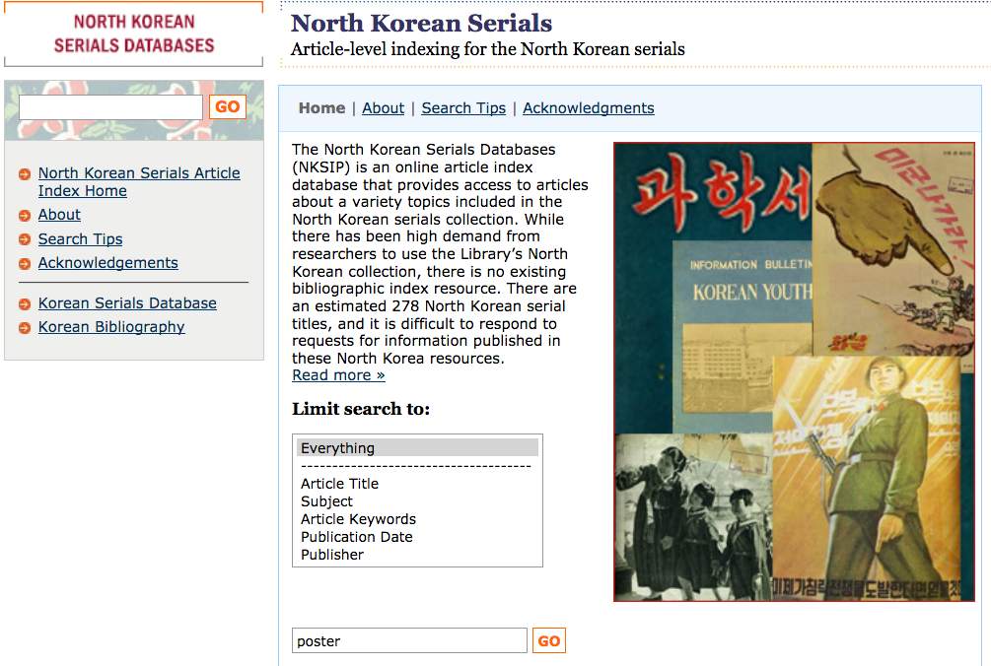
NKSIP - Search by: 도표, 그림, 시, 표어
Everything
poster
Notes:
You may search by different types of materials.
For example, you can write “topyo” “ kurim” “si”, “painting,” or “poster” under the "Everything” option.

Slide 43

North Korean Serials Indexing Project
(NKSIP)
Notes:
[Future plans: ]
The Library’s support / has already built / the basis of an incredible database, which is nearly completed. Soon, it will be released to the public, (maybe ) in a few weeks. We welcome any comments or suggestions you may have on NKSIP.
(NK Serial Collection is one of our popular collections. So, digitization of this collection is our top priority in the future.)

Slide 44

Sonya Lee
slee@loc.gov
Notes:
Lastly, I have an announcement to make: Dr. Dafna Zur (쥬어) from the Stanford University will deliver her talk / on “Moral Science in Postwar North Korea” on March 26 Monday at 12:00pm at the Library. If you still in town, please join us then.
This concludes my presentation. Thank you for your attention.

